Slide 1

Basic custom component creation guide for psoc creator
Designing custom hardware in PSOC using verilog
2019 – agosdahu

Slide 2


Component creation within a project

Slide 3
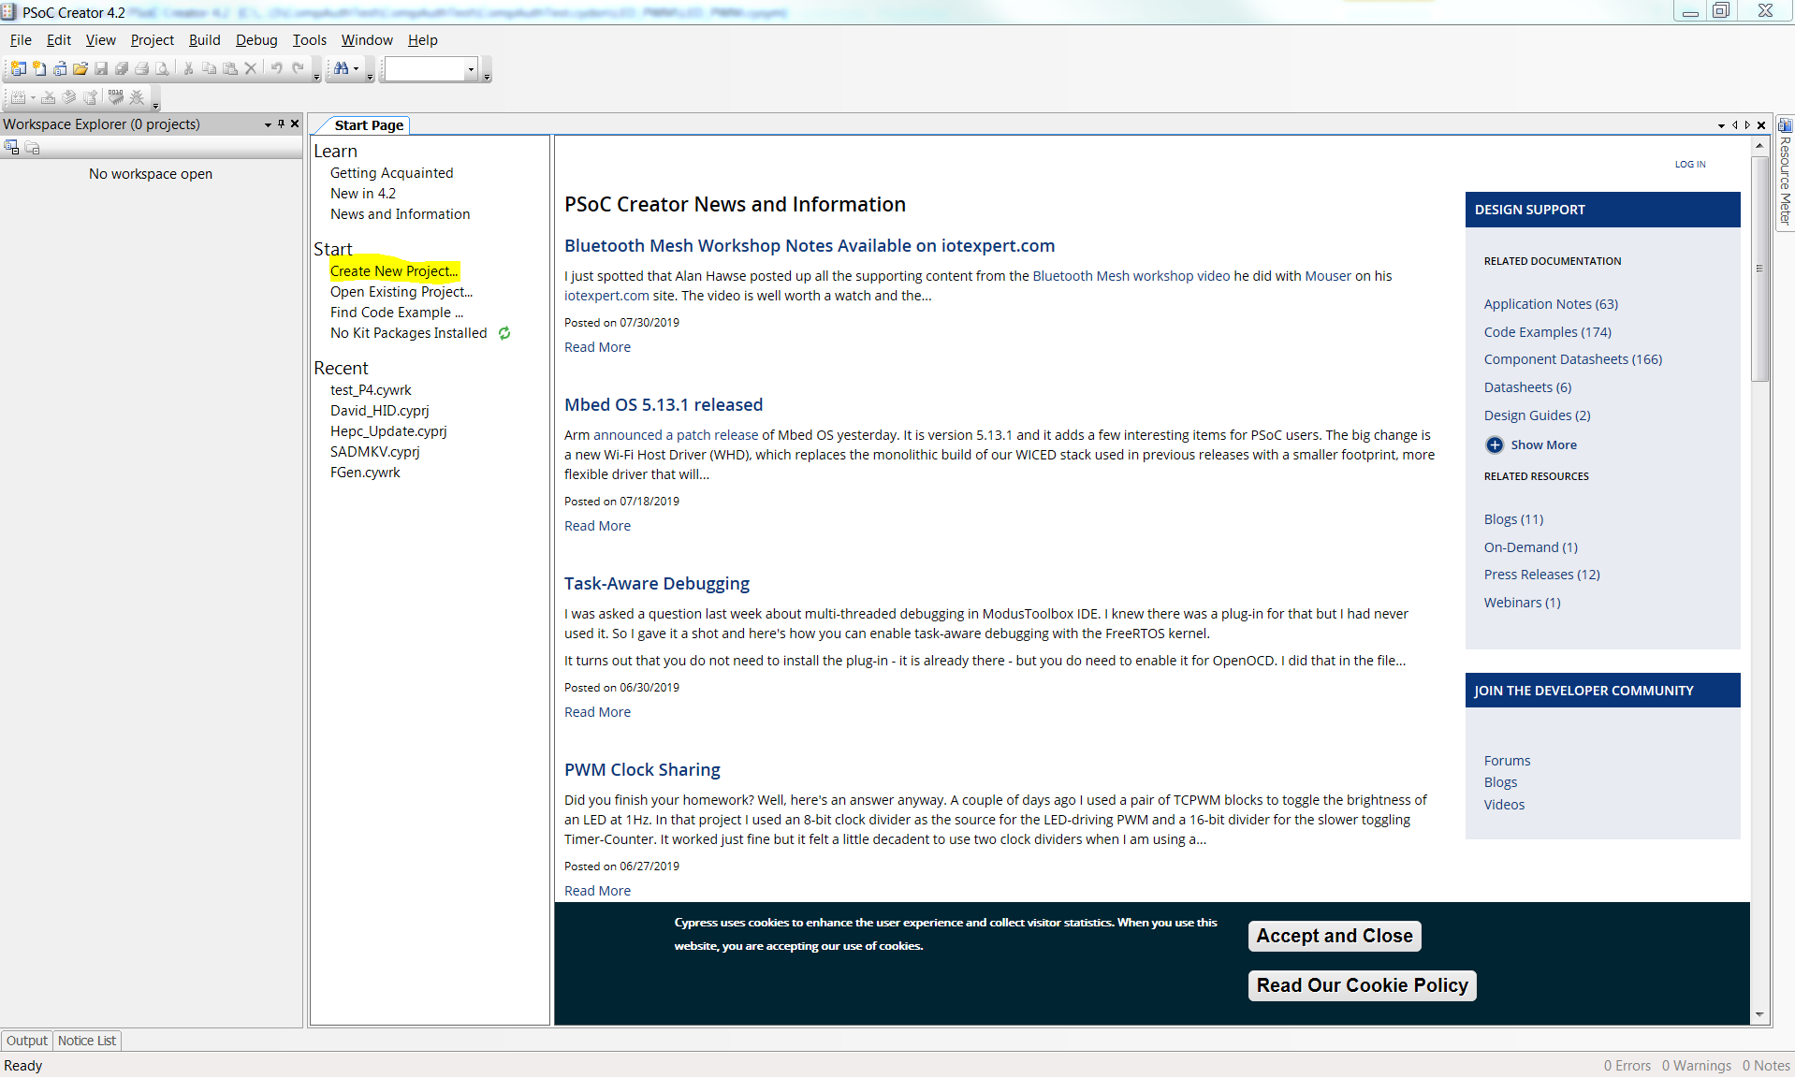
Create a new project

Slide 4
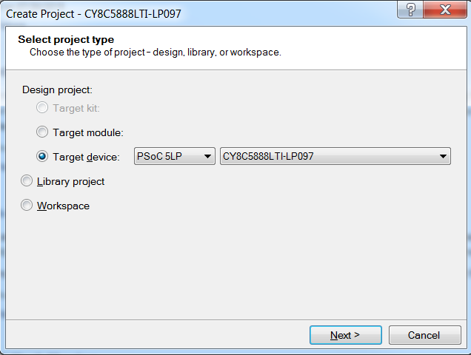
Select the chip corresponding to the PSoC5 Prototyping board

Slide 5
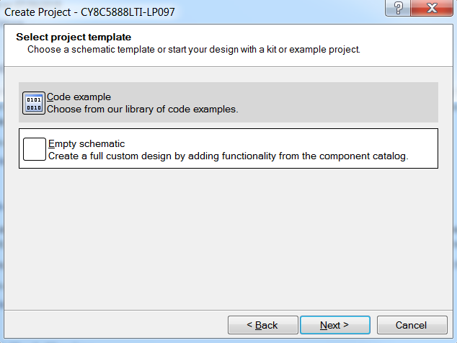
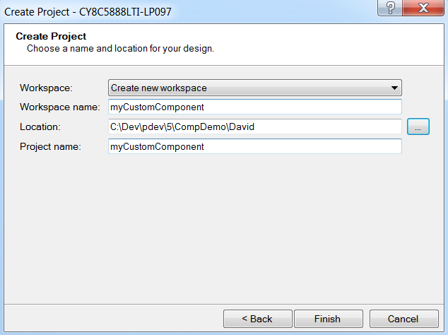
Finalise project parameters and finish

Slide 6

Creating a symbol with a Wizard

Slide 7
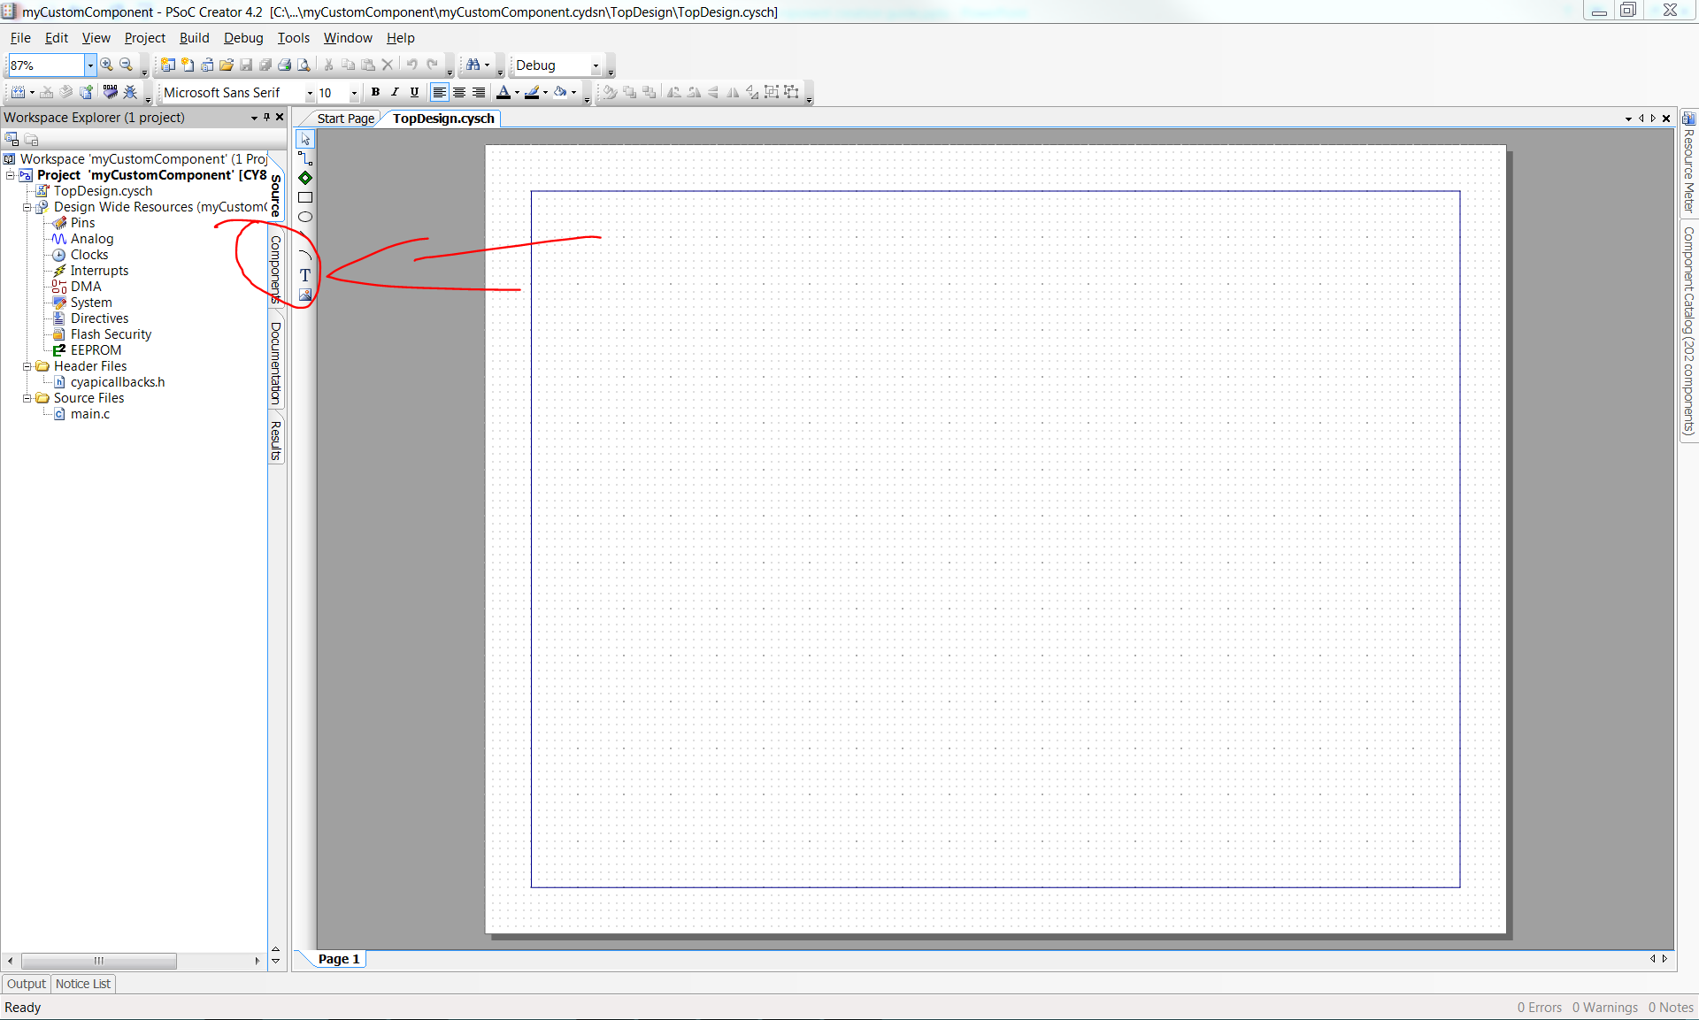
Starting with a custom component
Under the Components tab, a custom component can be made locally

Slide 8
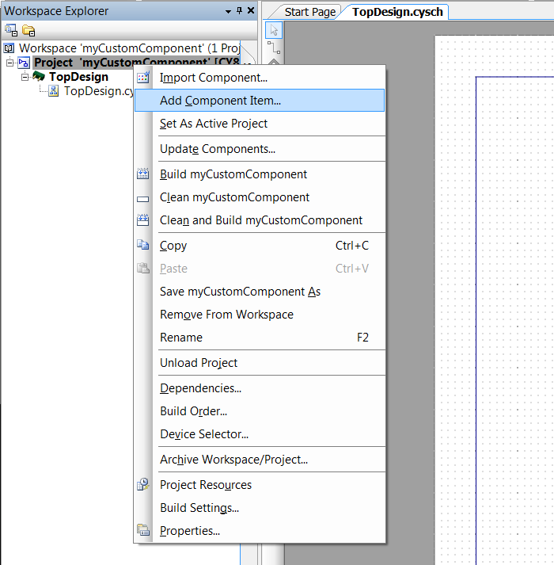
Adding a new component
Right click on the Project file
Select „Add Component”

Slide 9
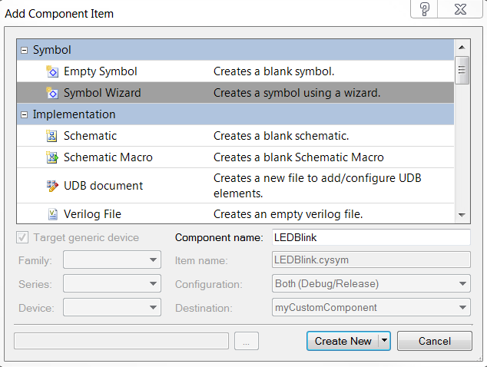
Set Component parameters
Select „Symbol Wizard”
Name the component
„Create new”
Notes: A component symbol is only a representation of your component on the drag&drop canvas (on the TopDesign)

Slide 10
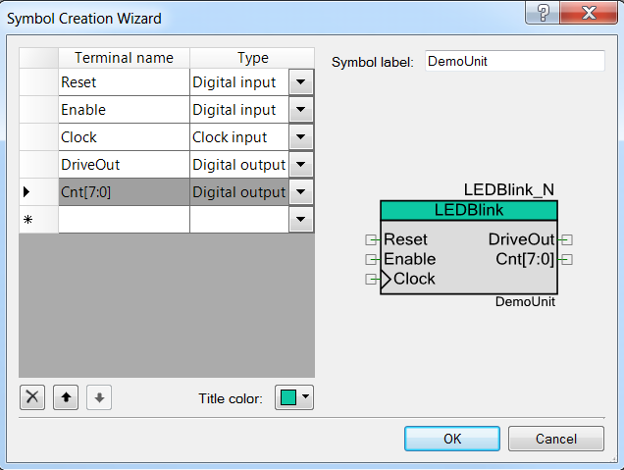
Defining terminals and further symbol customisation
Set input and output terminals
Optionally change component header colour and add a Symbol label (right-bottom corner)
Notes:
You can define vector terminals by using the „TerminalName[MSB:LSB]” convention.
If a terminal is defined as Clock input, the wizard generates the ubiquitously used symbol marking when creating the terminal.
You can always modify the symbol drawing later.

Slide 11
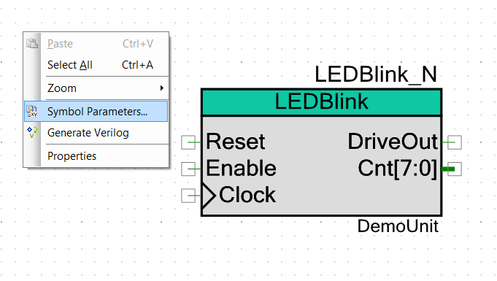
Editing Symbol parameters
Right click on canvas
„Symbol Parameters”

Slide 12
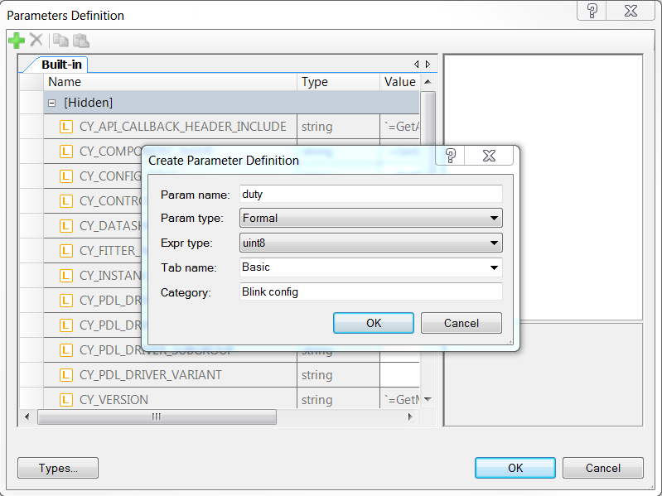
Adding Component parameters
Add a new parameter with the „GREEN PLUS” symbol
Define the paramater
Notes: Formal parameter type will be accessible by the user, while Local parameters are read-only.

Slide 13
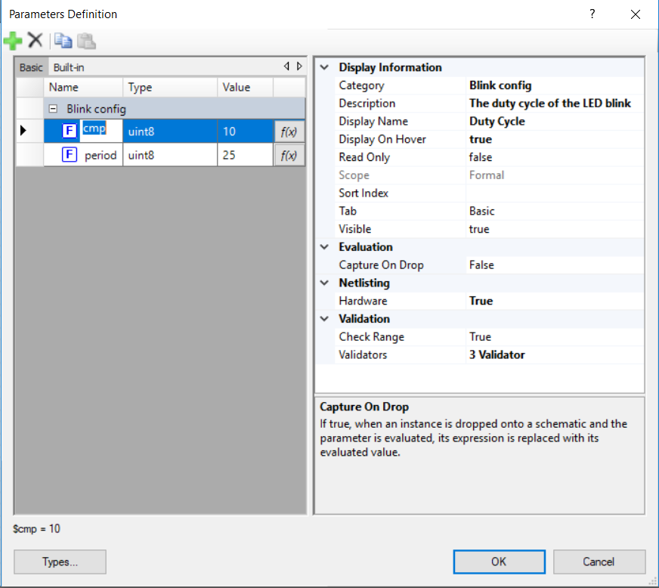
Component parameter additional settings
Select the parameter
Optionally define display information
Set Netlisting/Hardware option to TRUE
Validator setting is highly advised (Click on the Validation/Validators option then select the now-visible button with 3 dots in it)

Slide 14
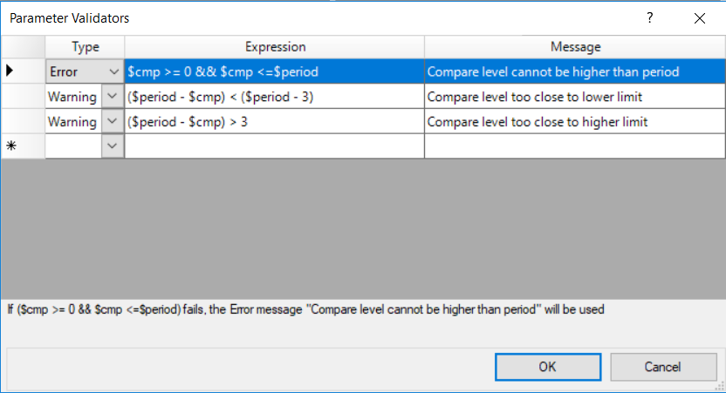
Parameter validators
Set validator types
Define an expression that should be TRUE
Define the message which will be displayed in case the expression is evaluated to be false.
Notes: the parameter is referenced by its name with a ‚$’ symbol as a prefix

Slide 15
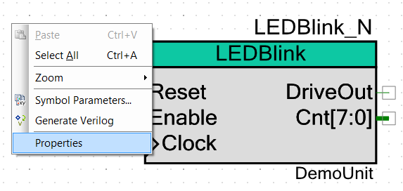
Symbol properties
- Right Click again on the canvas and select properties

Slide 16
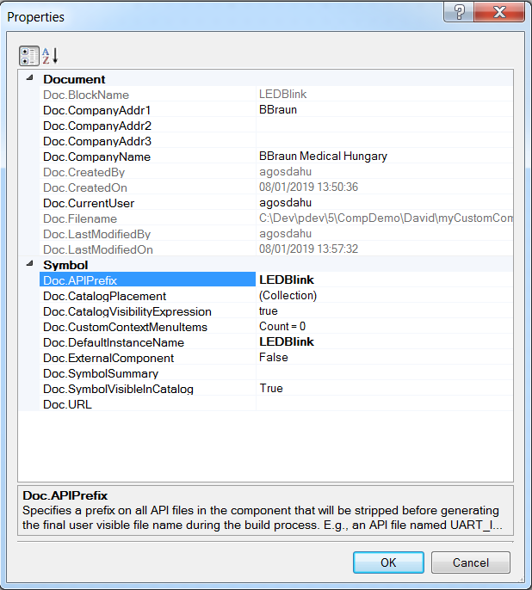
Property settings
Fill out the relevant boxes
Notes:
Symbol/APIPrefix should be the component instance name. This expression will be omitted from the generated API names. Fun fact, the full API name originally consists the component name and the local instance name as well.
Symbol/Doc.CatalogPlacement parameter should be changed in case you would like to organise your components inside the Component Catalogue (on TopDesign. See next slide)

Slide 17

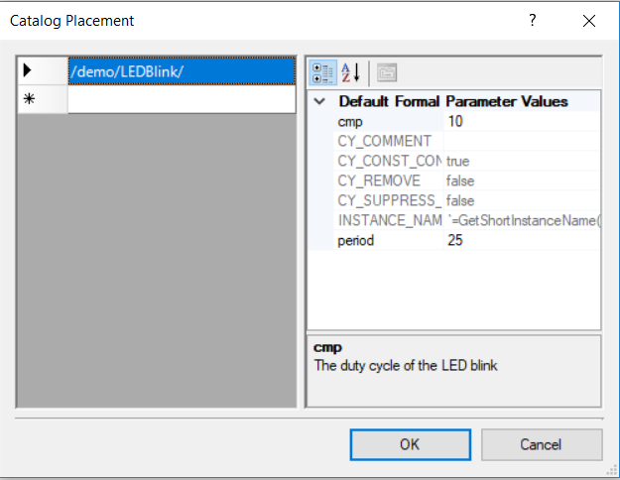
Catalogue placement
Important note:
If the path defined does not end with a component (it does not need to), then it should be finished with a ‚/’ symbol

Slide 18
Using Verilog

Slide 19
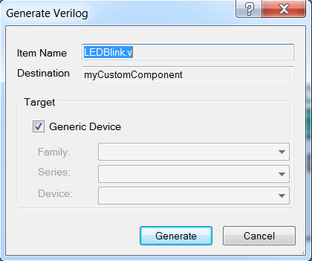
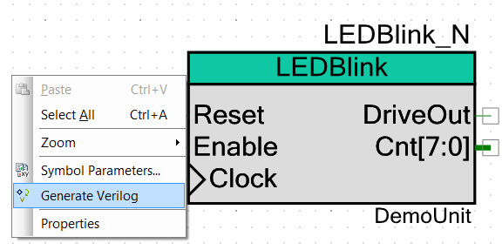
Generating source
If all parameters are set (especially the Formal parameter part), right click on canvas and generate the verilog file
Generic Device setting is OK
Notes: you can always re-generate your verilog file, but be aware that your port list and the parameters will also be re-generated

Slide 20

Learn Verilog

Slide 21
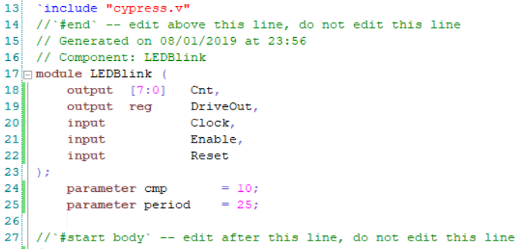
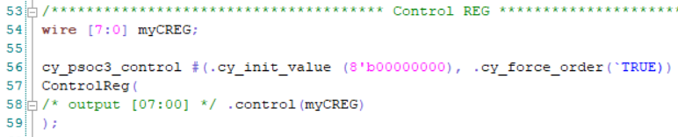
Verilog code examples (1/2)
Module instantiation
Control Register instantiation

Slide 22
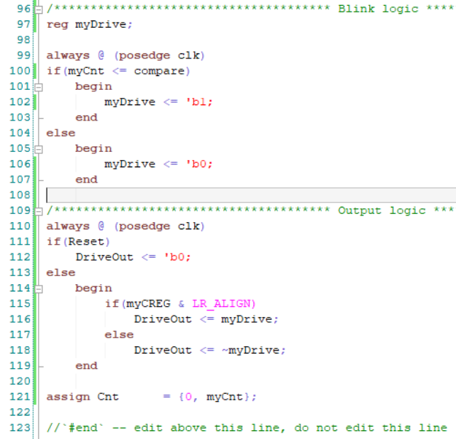
Verilog code examples (2/2)
Basic logic example

Slide 23
Creating the API functions

Slide 24
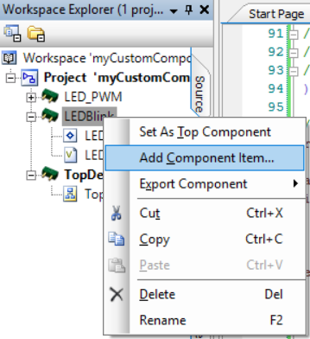
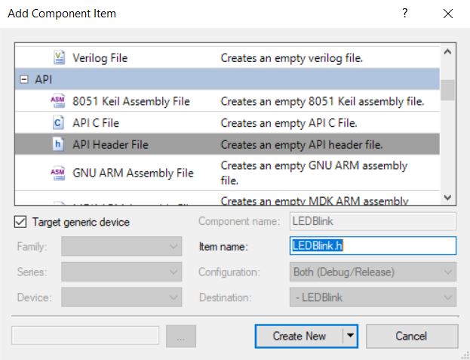
Adding the API component items (*.h, *.c)
Usual right-click on component
Select and name each respective header and source files

Slide 25
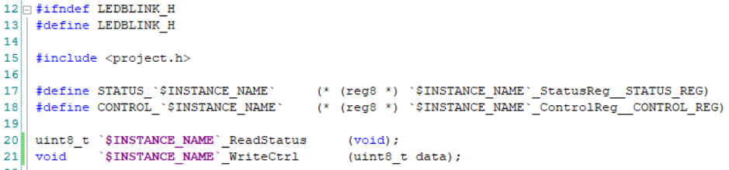

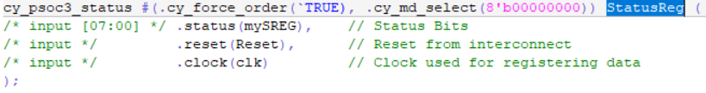
Header file (example)
Cypress will automatically generate these files with the right instance name.
The same way it’s done with any other standard component
See instance names in Verilog file:

Slide 26
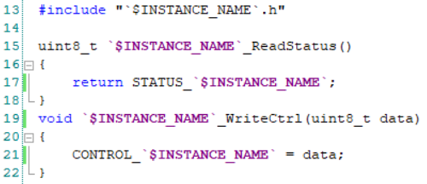
Source Files (example)
Register content expressed via using the defines in header

Slide 27
Notes
Please be mindful of the manufacturers datasheet instructions at all time, especially concerning the cypress provided hardware modules to save time on design implementation (e.g.: Counter7 needs to be enabled from both hardware and software -> see example design)

Slide 28
Creating a library project

Slide 29
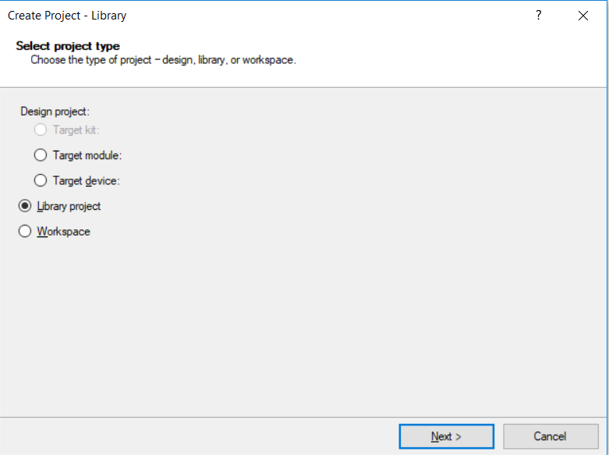
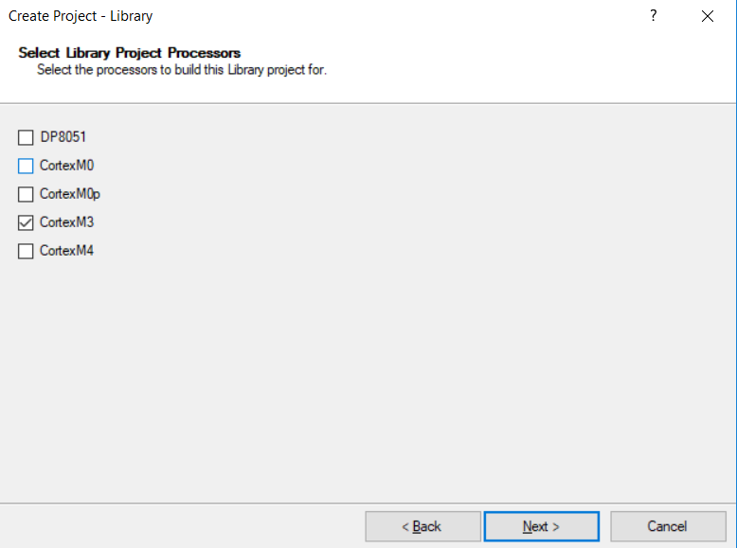
Create a library project (File->new->Project…)
Select the one which you need. CM3 is the core within a PSoC5

Slide 30
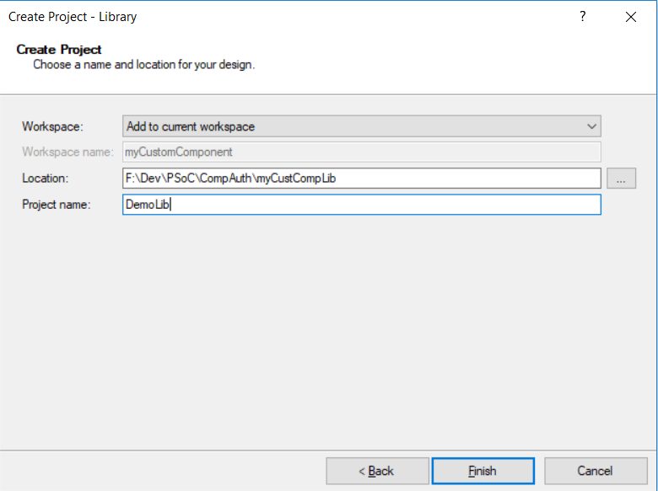
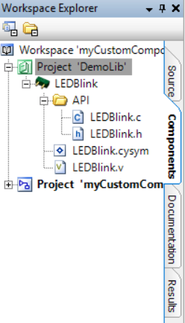
Creating the components within the Library Project
Custom components are to be created within the library project.
Set parameters
Keep in mind that an independent library should be located independently from other project repositories

Slide 31
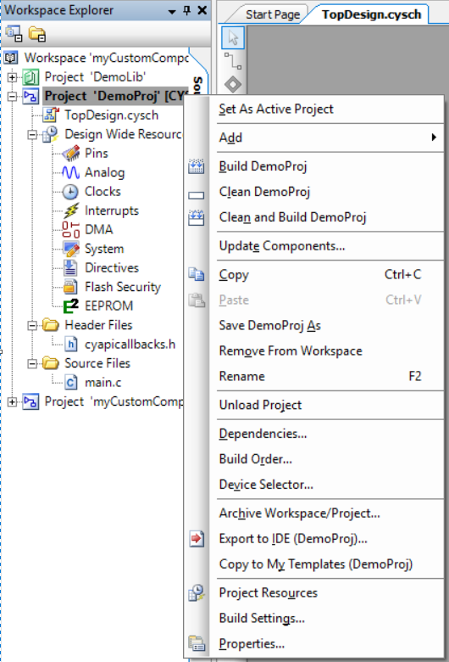
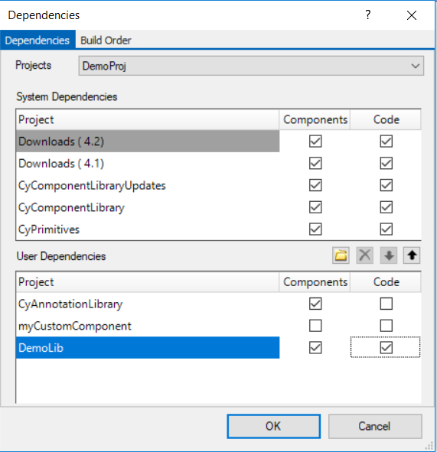
How to include components to a new project
Right-click
Browse for Library project and add to list
Select both component and Code dependency

Slide 32
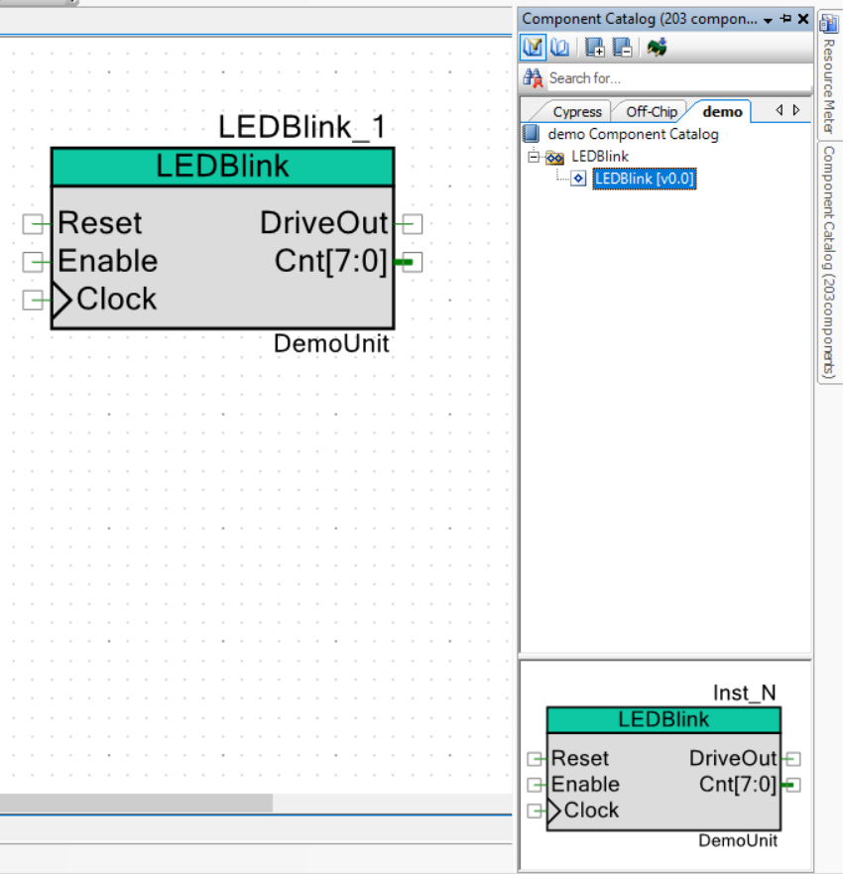
Final steps
The previously defined additional tab is now available for the User, along with the new component, which can be drag&dropped onto the canvas
After Synthesis and API generation, the component is ready to be used within the design

Slide 33
To further expand your competence of the topic, please look for the official Cypress documentation, as listed below:
Component Author guide
Digital Design Best Practices
PSoC 3 and PSoC 5LP Hardware Design Considerations
Designing PSoC Creator components with UDB datapaths
Datapath Configuration Tool User Guide
Implementing programmable logic designs with Verilog
Creating a verilog based component
Just enough Verilog for PSoC
TRM
…etc.

